Slide 1
www.acrhouston.org
ACR Houston Annual Meeting
Recap 2023: Chapter Highlights
Sheryl Jackson-Matthews, ACR Houston President
January 29, 2024

Slide 2
Greetings from the President

Slide 3
ACR Houston Board Election
Vote for 2024
ACRH Board of Directors
https://forms.gle/hyWhFJnm6r51iFAb6
January 29, 2024

Slide 4
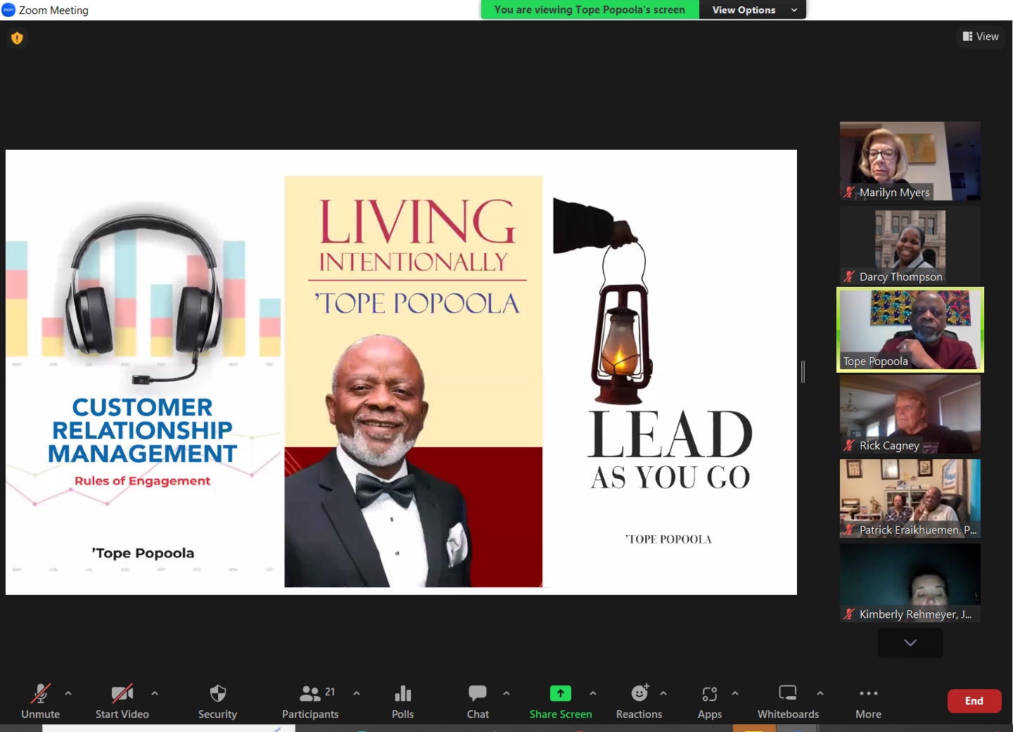
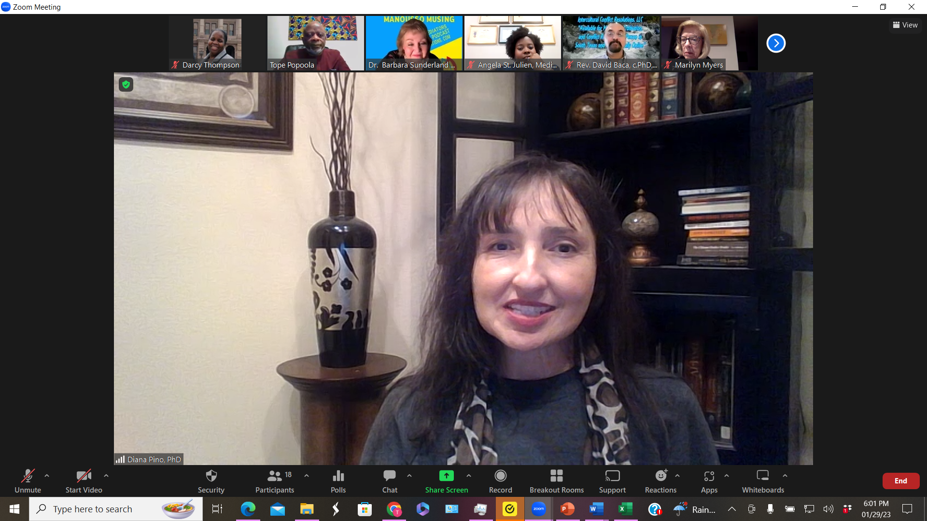
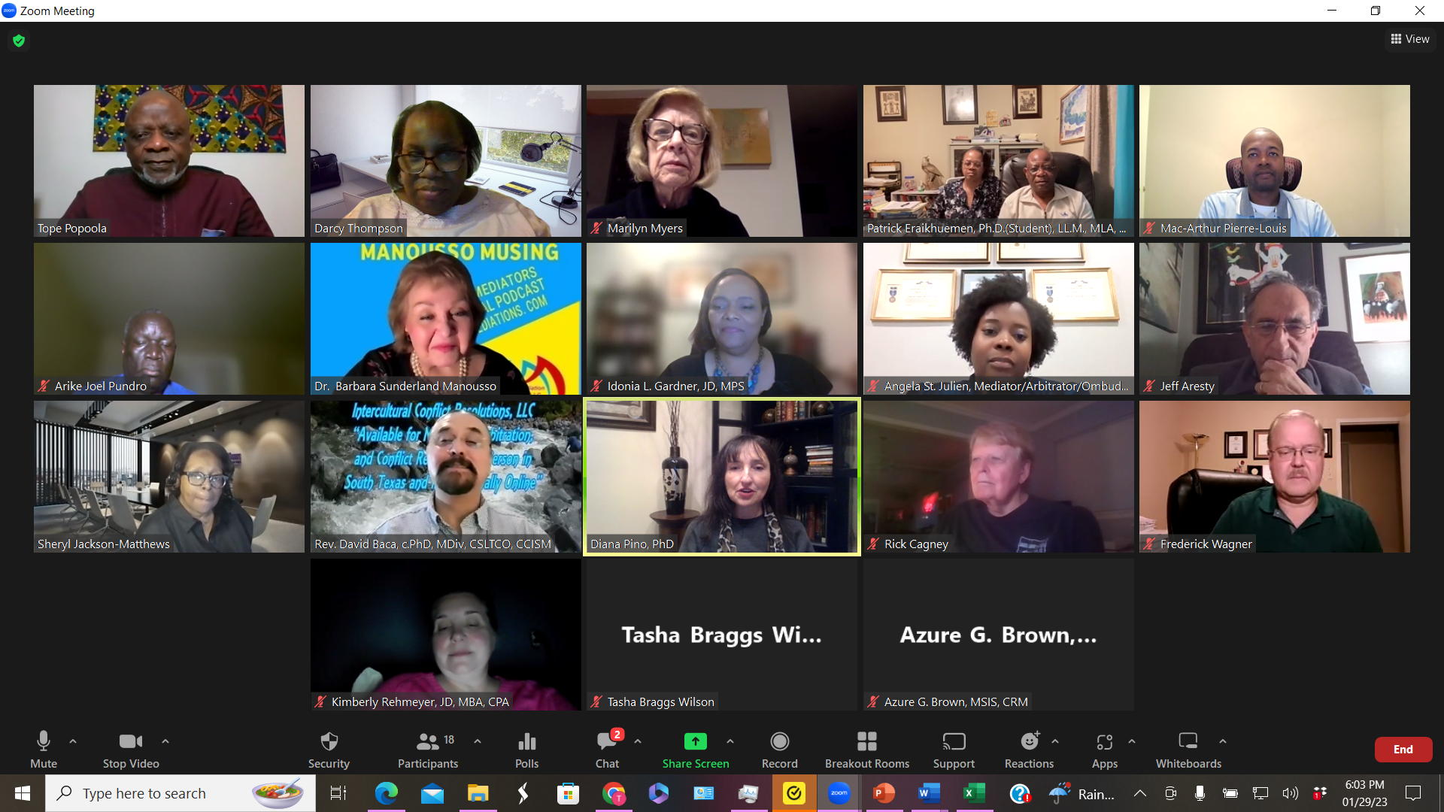
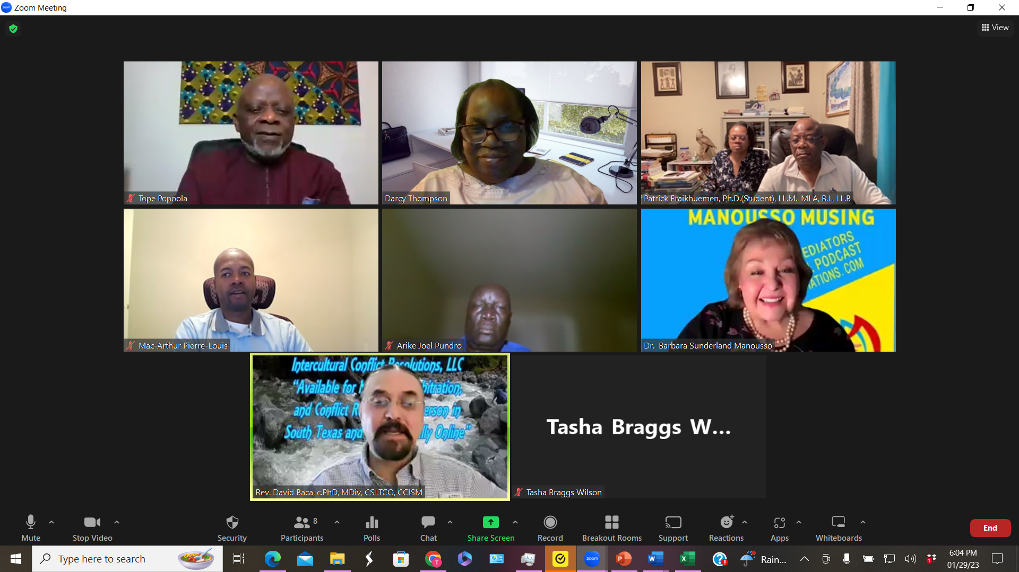
ACRH Annual Meeting and
Winter Social (Virtual Event)
Dr. Diana Pino,
ACR Houston President 2022
January 29, 2023

Slide 5
Sponsored Event

Slide 6
SHSU Conflict Resolution Month 2023
Webinar Series
Sponsored Event
Conflict Resolution Month
October 2023

Slide 7
Association for Conflict Resolution,
Greater New York Chapter
November 8, 2023

Slide 8
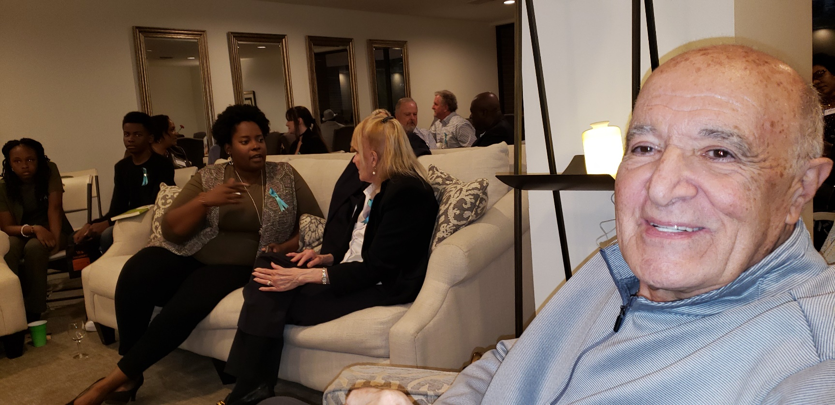
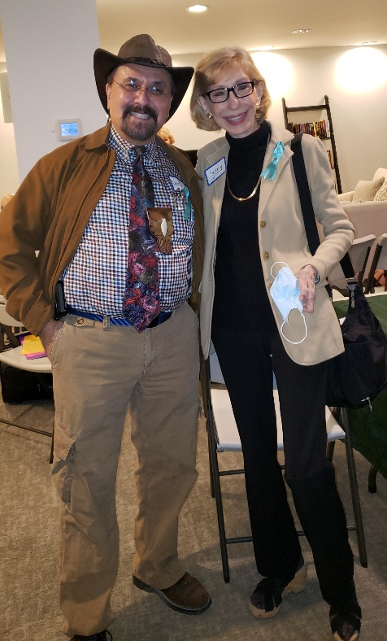
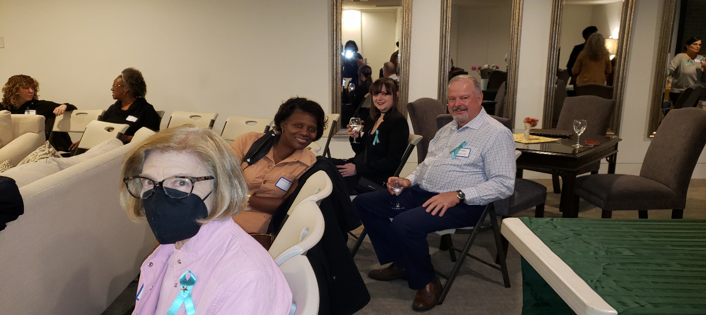
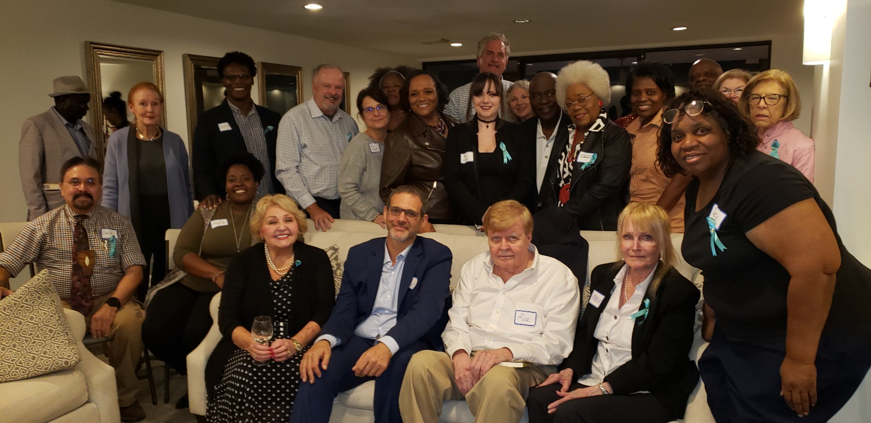
November 12, 2023
Luke Archer
Verbal Aikido
Speaker Series

Slide 9
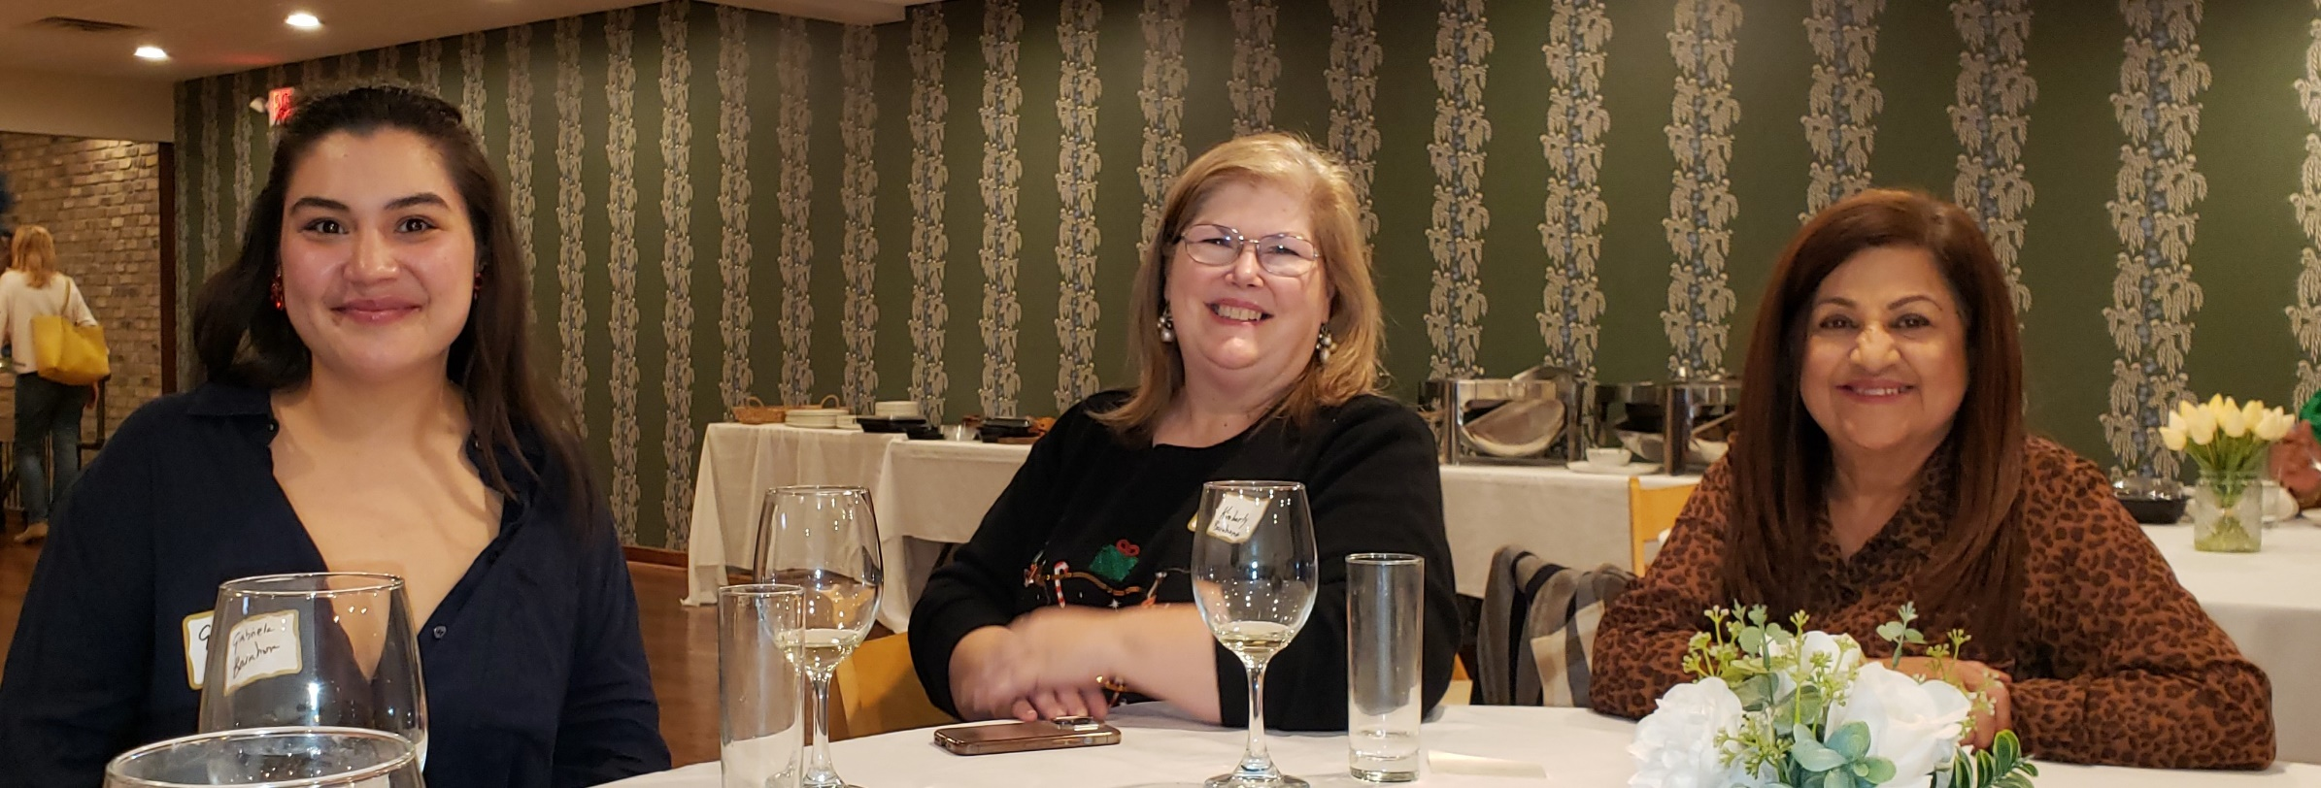
LERA, TAM AND ACR Houston
A Festivus for the Rest of Us
Co-sponsored by ACR Houston, Texas Association of Mediators (TAM), Labor and
Employment Relations Association, (LERA) Houston Chapter, Pat Flynn, Mickey Brock,
Dr. Barbara Sunderland Manousso, Arbitrator Nadine Littles JD, and John Harper-Littler
Houston Fire Department Stocking Stuffer Benefit
December 6, 2023
Notes:
12

Slide 10
Co-Sponsors/Supporters of
Events & Organizations...
Association for Conflict Resolution, Greater New York Chapter
Labor and Employment Relations Association (LERA) Houston Chapter
Sam Houston State University Student Legal & Mediation Services
Texas Association of Mediators (TAM)
Notes:
As usual, ACRH collaborates with and supports other organizations committed to peaceful dispute resolution.

Slide 11
peermediation@acrhouston.org
Let us help build your peaceful community!
Dedicated to the practice and understanding of peaceful conflict resolution at all ages
9
Notes:
The ACR Houston Peer Mediation Team has a great team. If you’re a trainer, facilitator or other PMT member, please use your Reaction Button to raise your hand. We have a great program that can be offered in person or virtually.
One of the significant lingering issues of the pandemic is the impact on the social emotional learning of children. Peer mediation is a recognized support that has a positive impact on SEL. If you know of a school or program that wants help, please share our contact information.

Slide 12
Results of
Board Election

Slide 13
Upcoming Event
Notes:
16

Slide 14
Thank You

Slide 15
The End
Notes:
17

